Slide 1
Earthquake Contingency Planning in Nepal to Save life and property

Slide 2
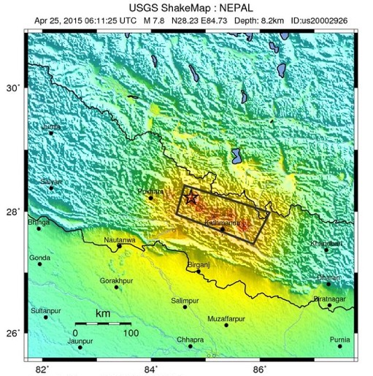
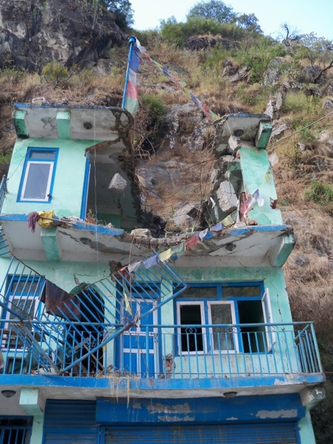
Overview
2015 Gorkha earthquake was worst in 90 years
8970 fatalities, 22,309 injuries, 3.5 million displaced
Not as large as had been expected – M_{w} 8.5+ earthquake anticipated with 100,000+ fatalities (Dixit et al 2014; Bilham et al. 2001, Wyss, 2005)
Scope of this planning:
  To forecast absolute impacts to residential buildings:
    Fatalities
    Injuries
    Building Collapse
    Displaced population
  Focus on large EQs requiring International response
    M7.0 – M8.6
  Results at all Administrative levels
Rockfall damage in Kodari

Slide 3
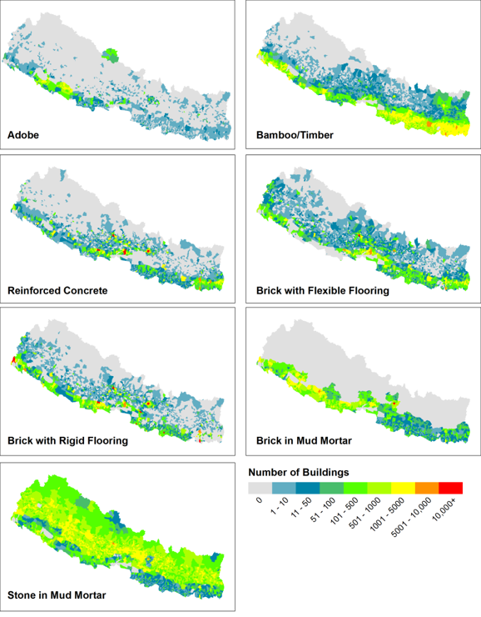
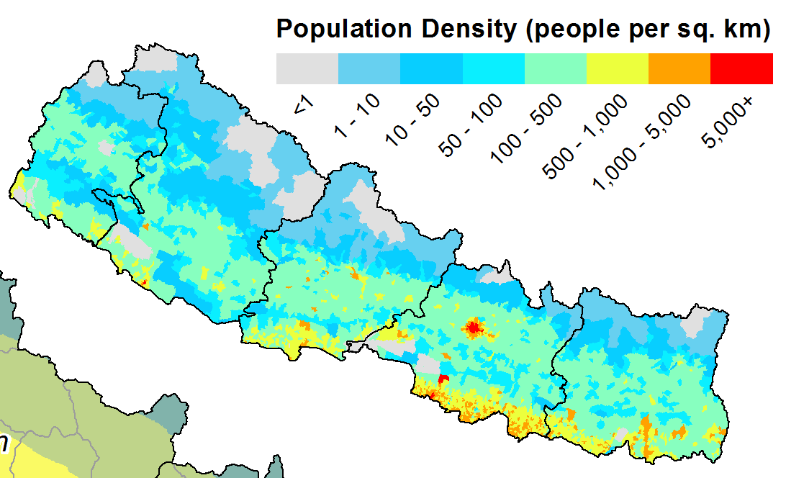
Earthquake Loss Modelling
Population and building data from 2011 National Census
Fragility curves and fatality rates from global empirical data (Guragain, 2012; HAZUS, GEMECD)
Verified on the 2015 earthquake
30 EQs for 3 different times = 90 scenarios
GoN 2011 Census
GoN 2011 Census
GEM & NSET
Building Typology | Fatality Rate
Adobe | 5.0%
Bamboo | 0.5%
Timber | 2.0%
Reinforced Concrete | 10.0%
Brick with flexible flooring | 5.0%
Brick with rigid flooring | 15.0%
Brick in mud mortar | 5.0%
Stone in mud mortar | 5.0%
HAZUS & Emily So

Slide 4
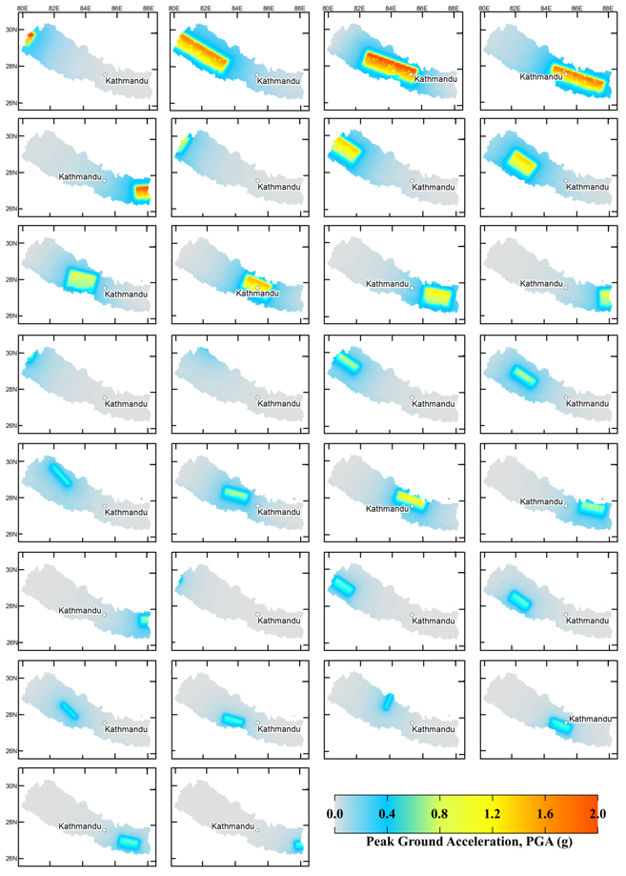
Scenario Ensembles
Scenario (Location-Fault_Mag) | Time of Day
 | Work Day | Non-work Day | Night
Wind-MFT_8.6 | 10,631 | 16,023 | 24,137
FWMW-MFT_8.6 | 36,770 | 53,175 | 81,434
WC-MFT_8.6 | 74,256 | 85,299 | 144,394
CE-MFT_8.6 | 65,946 | 71,960 | 124,942
Eind-MFT_8.6 | 15,231 | 20,321 | 32,665
W-Ind-MFT_8.3 | 5,908 | 8,956 | 13,458
FW-MFT_8.3 | 15,907 | 24,490 | 36,544
MW-MFT_8.3 | 24,404 | 37,559 | 56,089
W-MFT_8.3 | 32,200 | 43,013 | 68,178
C-MFT_8.3 | 53,025 | 55,444 | 98,375
E-MFT_8.3 | 23,731 | 30,196 | 49,265
Eind-MFT_8.3 | 7,536 | 10,608 | 16,679
WInd-MFT_7.8 | 3,100 | 5,070 | 7,429
FW-MFT_7.8 | 8,561 | 14,070 | 20,491
MW-MFT_7.8 | 12,796 | 21,050 | 30,638
W-MFT_7.8 | 19,644 | 26,476 | 41,891
C-MFT_7.8 | 38,333 | 36,876 | 68,301
E-MFT_7.8 | 9,739 | 14,316 | 22,200
Eind-MFT_7.8 | 3,791 | 5,911 | 8,902
WInd-MFT_7.0 | 856 | 1,298 | 1,958
FW-MFT_7.0 | 6,474 | 10,338 | 15,259
MW-MFT_7.0 | 8,518 | 13,645 | 20,090
W-MFT_7.0 | 11,369 | 16,400 | 25,114
C-MFT_7.0 | 28,038 | 23,261 | 46,414
E-MFT_7.0 | 6,882 | 9,916 | 15,537
Eind-MFT_7.0 | 2,267 | 3,372 | 5,134
SChn-KKM_7.8 | 166 | 323 | 523
MW-WFSN_7.8 | 5,292 | 9,023 | 13,042
MW-WFSS_7.3 | 7,361 | 12,134 | 17,727
W-TKG_7.3 | 1,560 | 2,531 | 3,798
Average | 18,010 | 22,768 | 37,020

Slide 5
Scenario Results
Worst-case - 144,394
Average (median) – 25,932
Most common – 5,000→10,000
Variability – 0.180

Slide 6
Variability
0.30
0.36
Zone of discretion?
0.00
0.33
0.66
1.00
Impacts are consistent and typically near to the minimum
Impacts are different in every different scenario
Impacts are consistent and typically near to the maximum
Plan for the AVERAGE because we know the worst-case is very unlikely
Plan for the WORST-CASE because we don’t know what impacts will occur
(precautionary approach)
Plan for the WORST-CASE because we know the worst-case is very likely

Slide 7
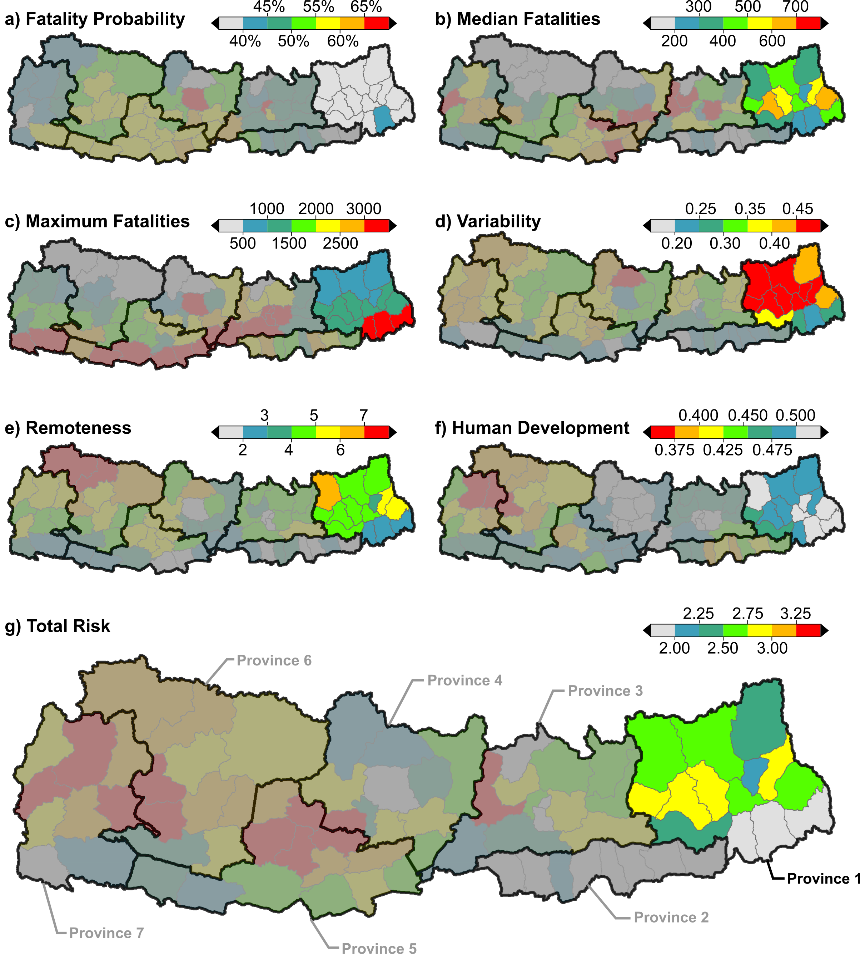
Province 1
Fatalities:
Likelihood: 43%
Average: 5,500
Worst-case: 20,000 Variability: 0.329 - Avg
Injuries:
Likelihood: 64%
Average: 18,000
Worst-case: 138,000
Variability: 0.295 - Avg
Building Damage:
Likelihood: 50%
Average: 24,000
Worst-case: 79,000 Variability: 0.423 - Max

Slide 8
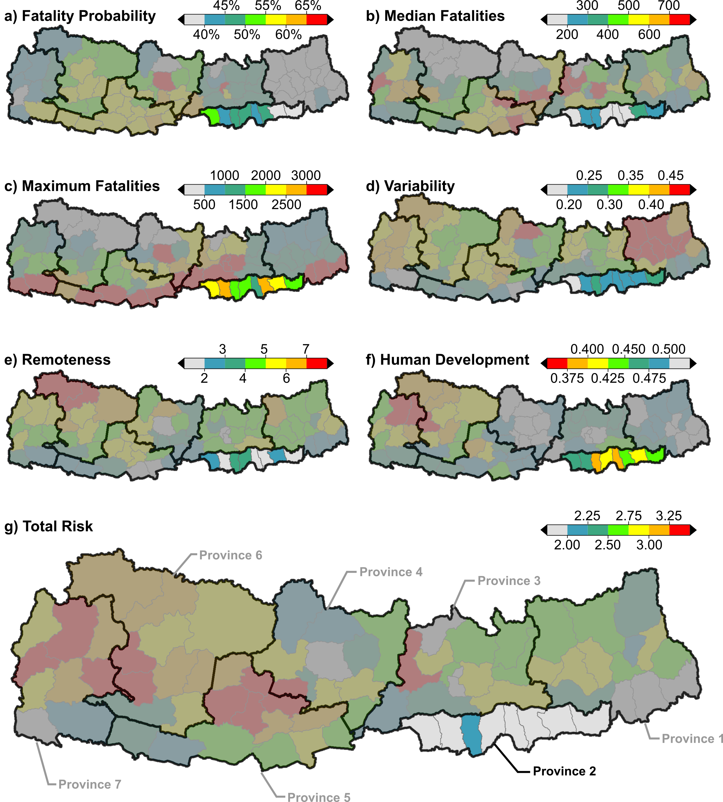
Province 2
Fatalities:
Likelihood: 59%
Average: 800
Worst-case: 17,000 Variability: 0.176 - Avg
Injuries:
Likelihood: 89%
Average: 3,000
Worst-case: 89,000
Variability: 0.165 - Avg
Building Damage:
Likelihood: 70%
Average: 3,000
Worst-case: 39,000 Variability: 0.231 - Avg

Slide 9
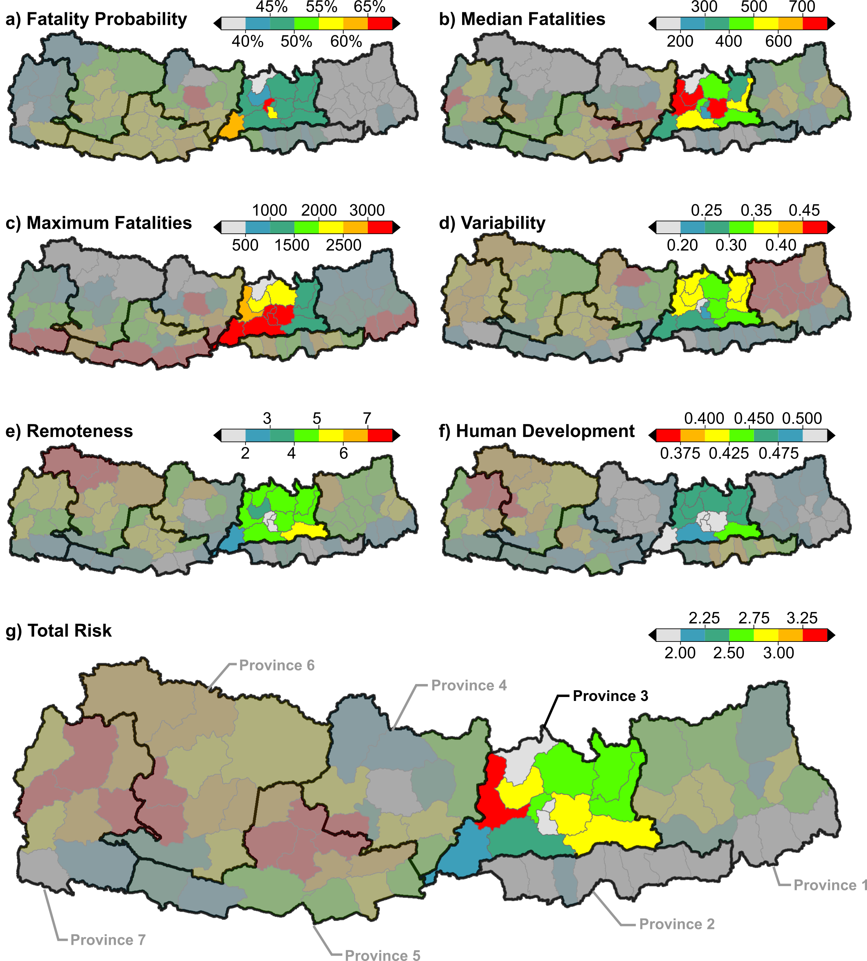
Province 3
Fatalities:
Likelihood: 72%
Average: 3,000
Worst-case: 58,000 Variability: 0.205 - Avg
Injuries:
Likelihood: 92%
Average: 10,000
Worst-case: 274,000
Variability: 0.217 - Avg
Building Damage:
Likelihood: 77%
Average: 11,000
Worst-case: 172,000 Variability: 0.289 - Avg

Slide 10
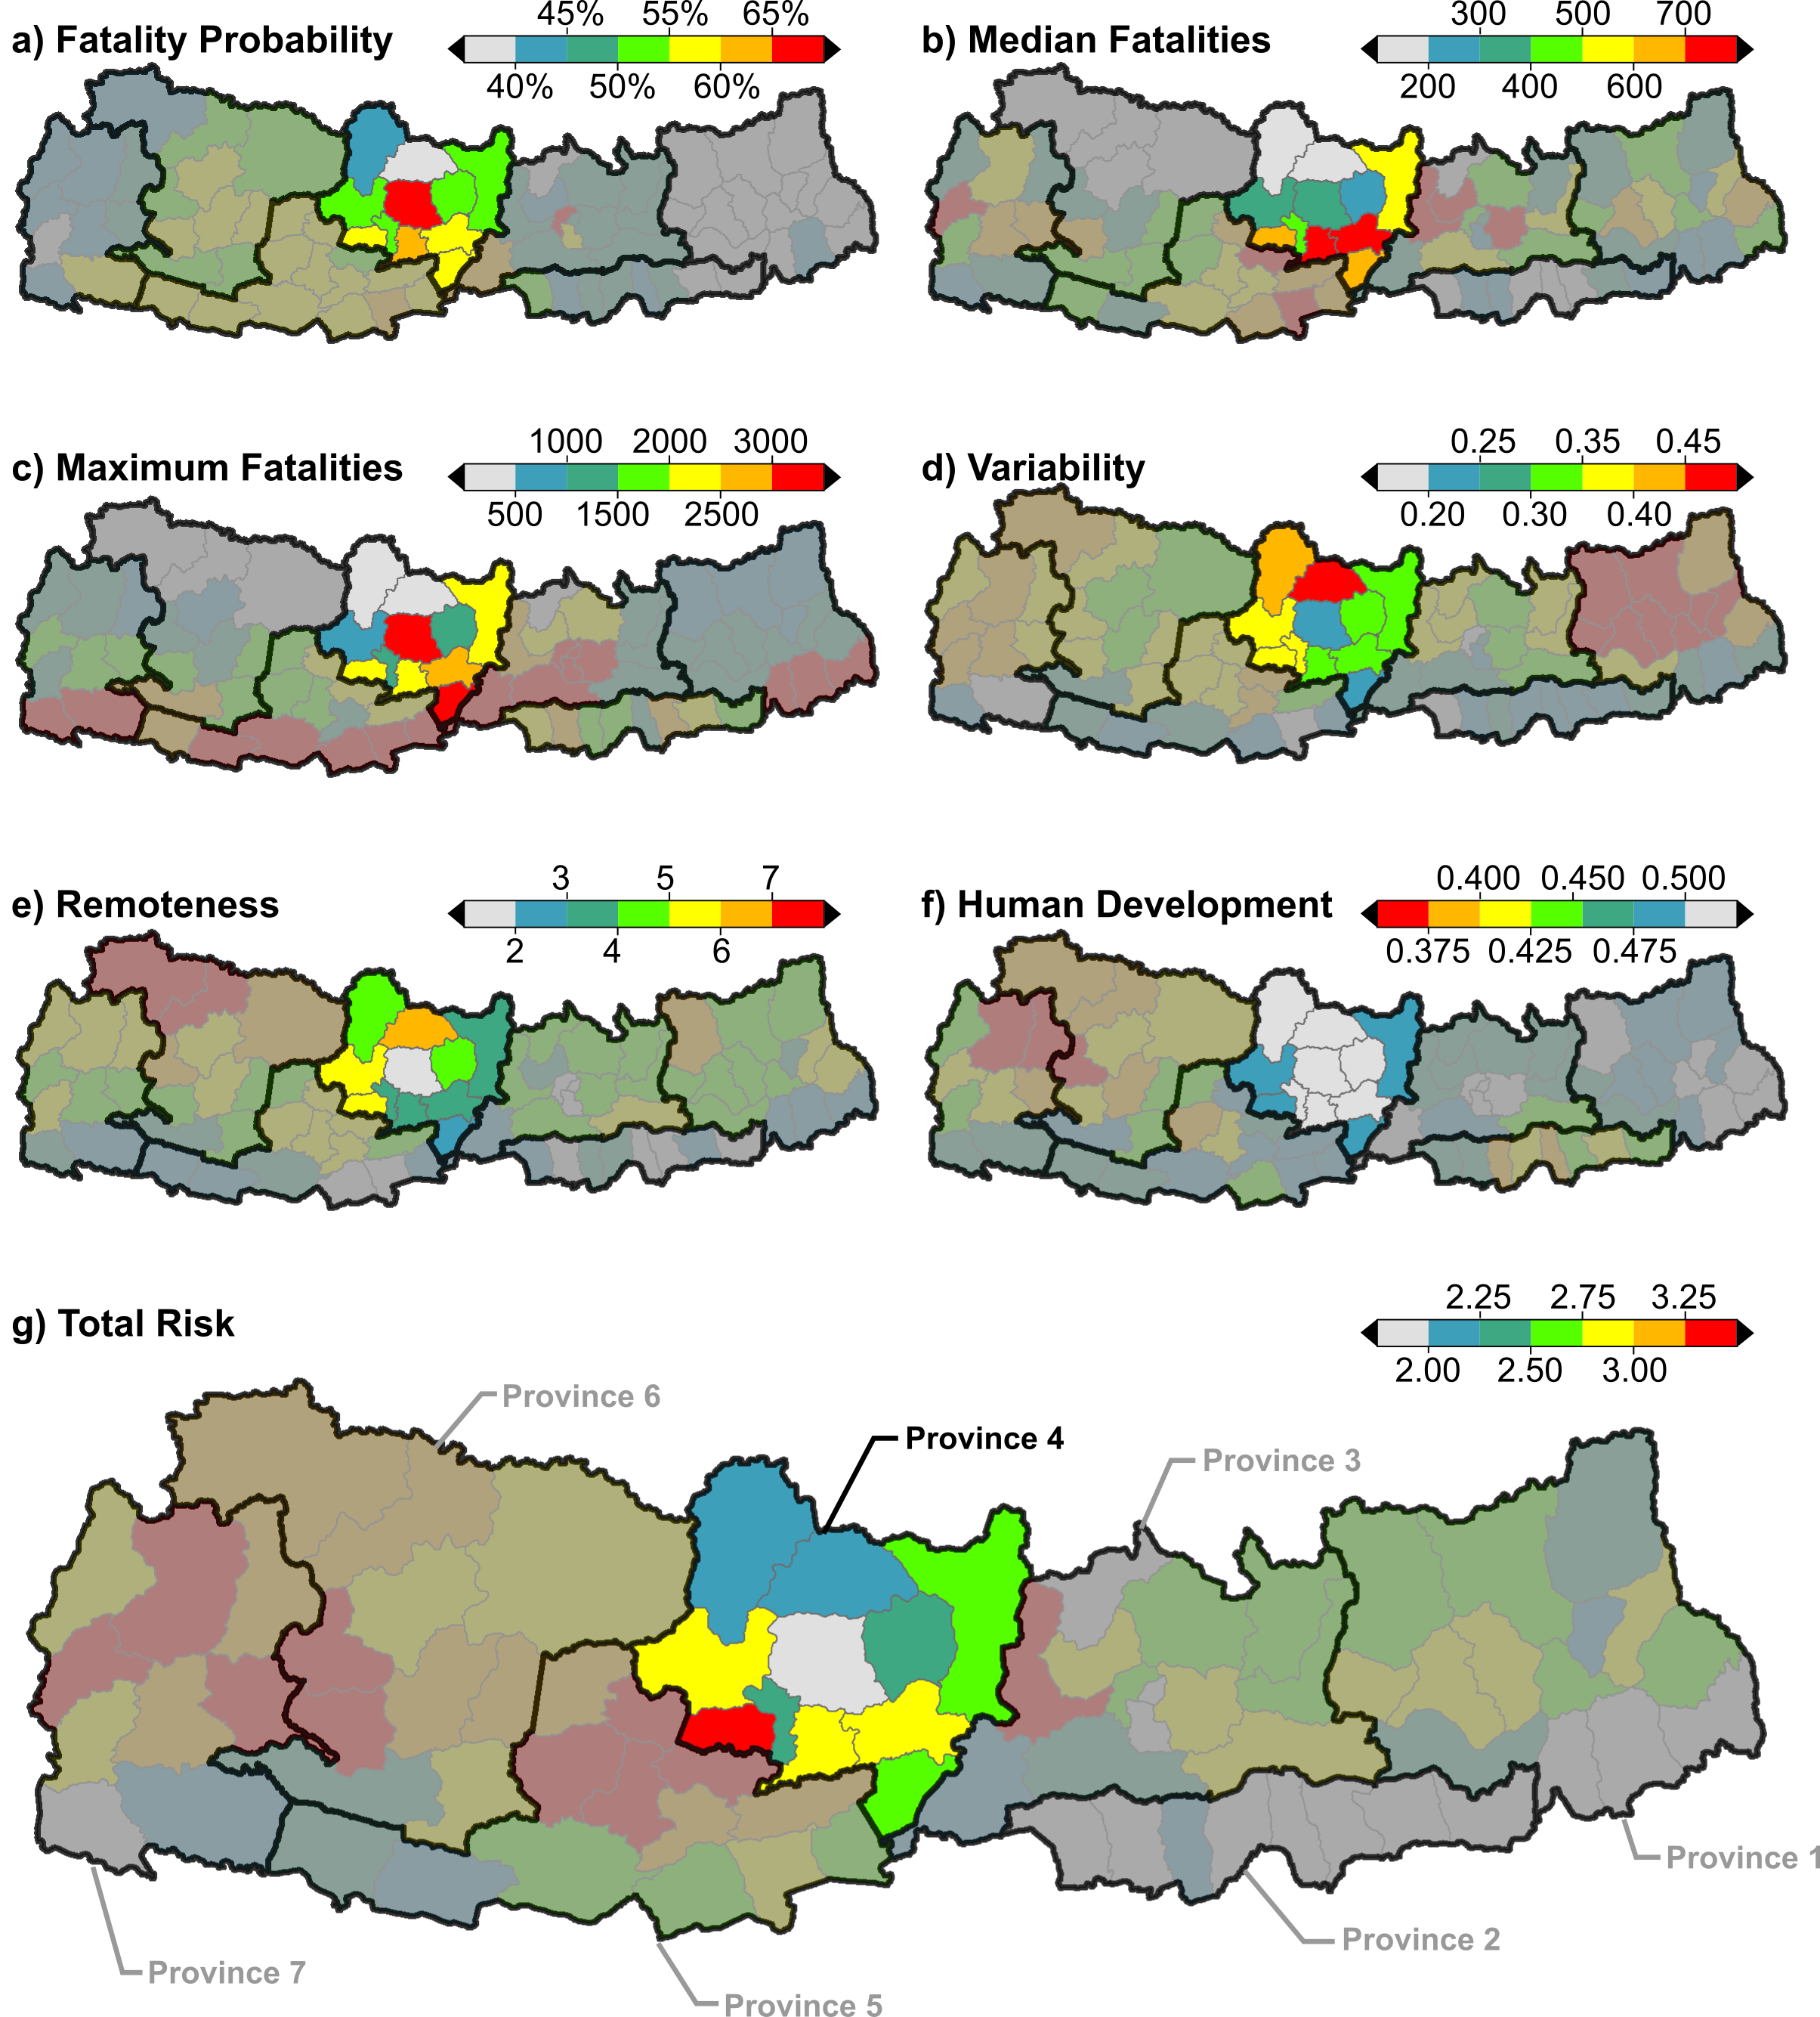
Province 4
Fatalities:
Likelihood: 84%
Average: 1,400
Worst-case: 20,000 Variability: 0.222 - Avg
Injuries:
Likelihood: 97%
Average: 8,000
Worst-case: 122,000
Variability: 0.249 - Avg
Building Damage:
Likelihood: 87%
Average: 11,000
Worst-case: 79,000 Variability: 0.319 - Avg

Slide 11
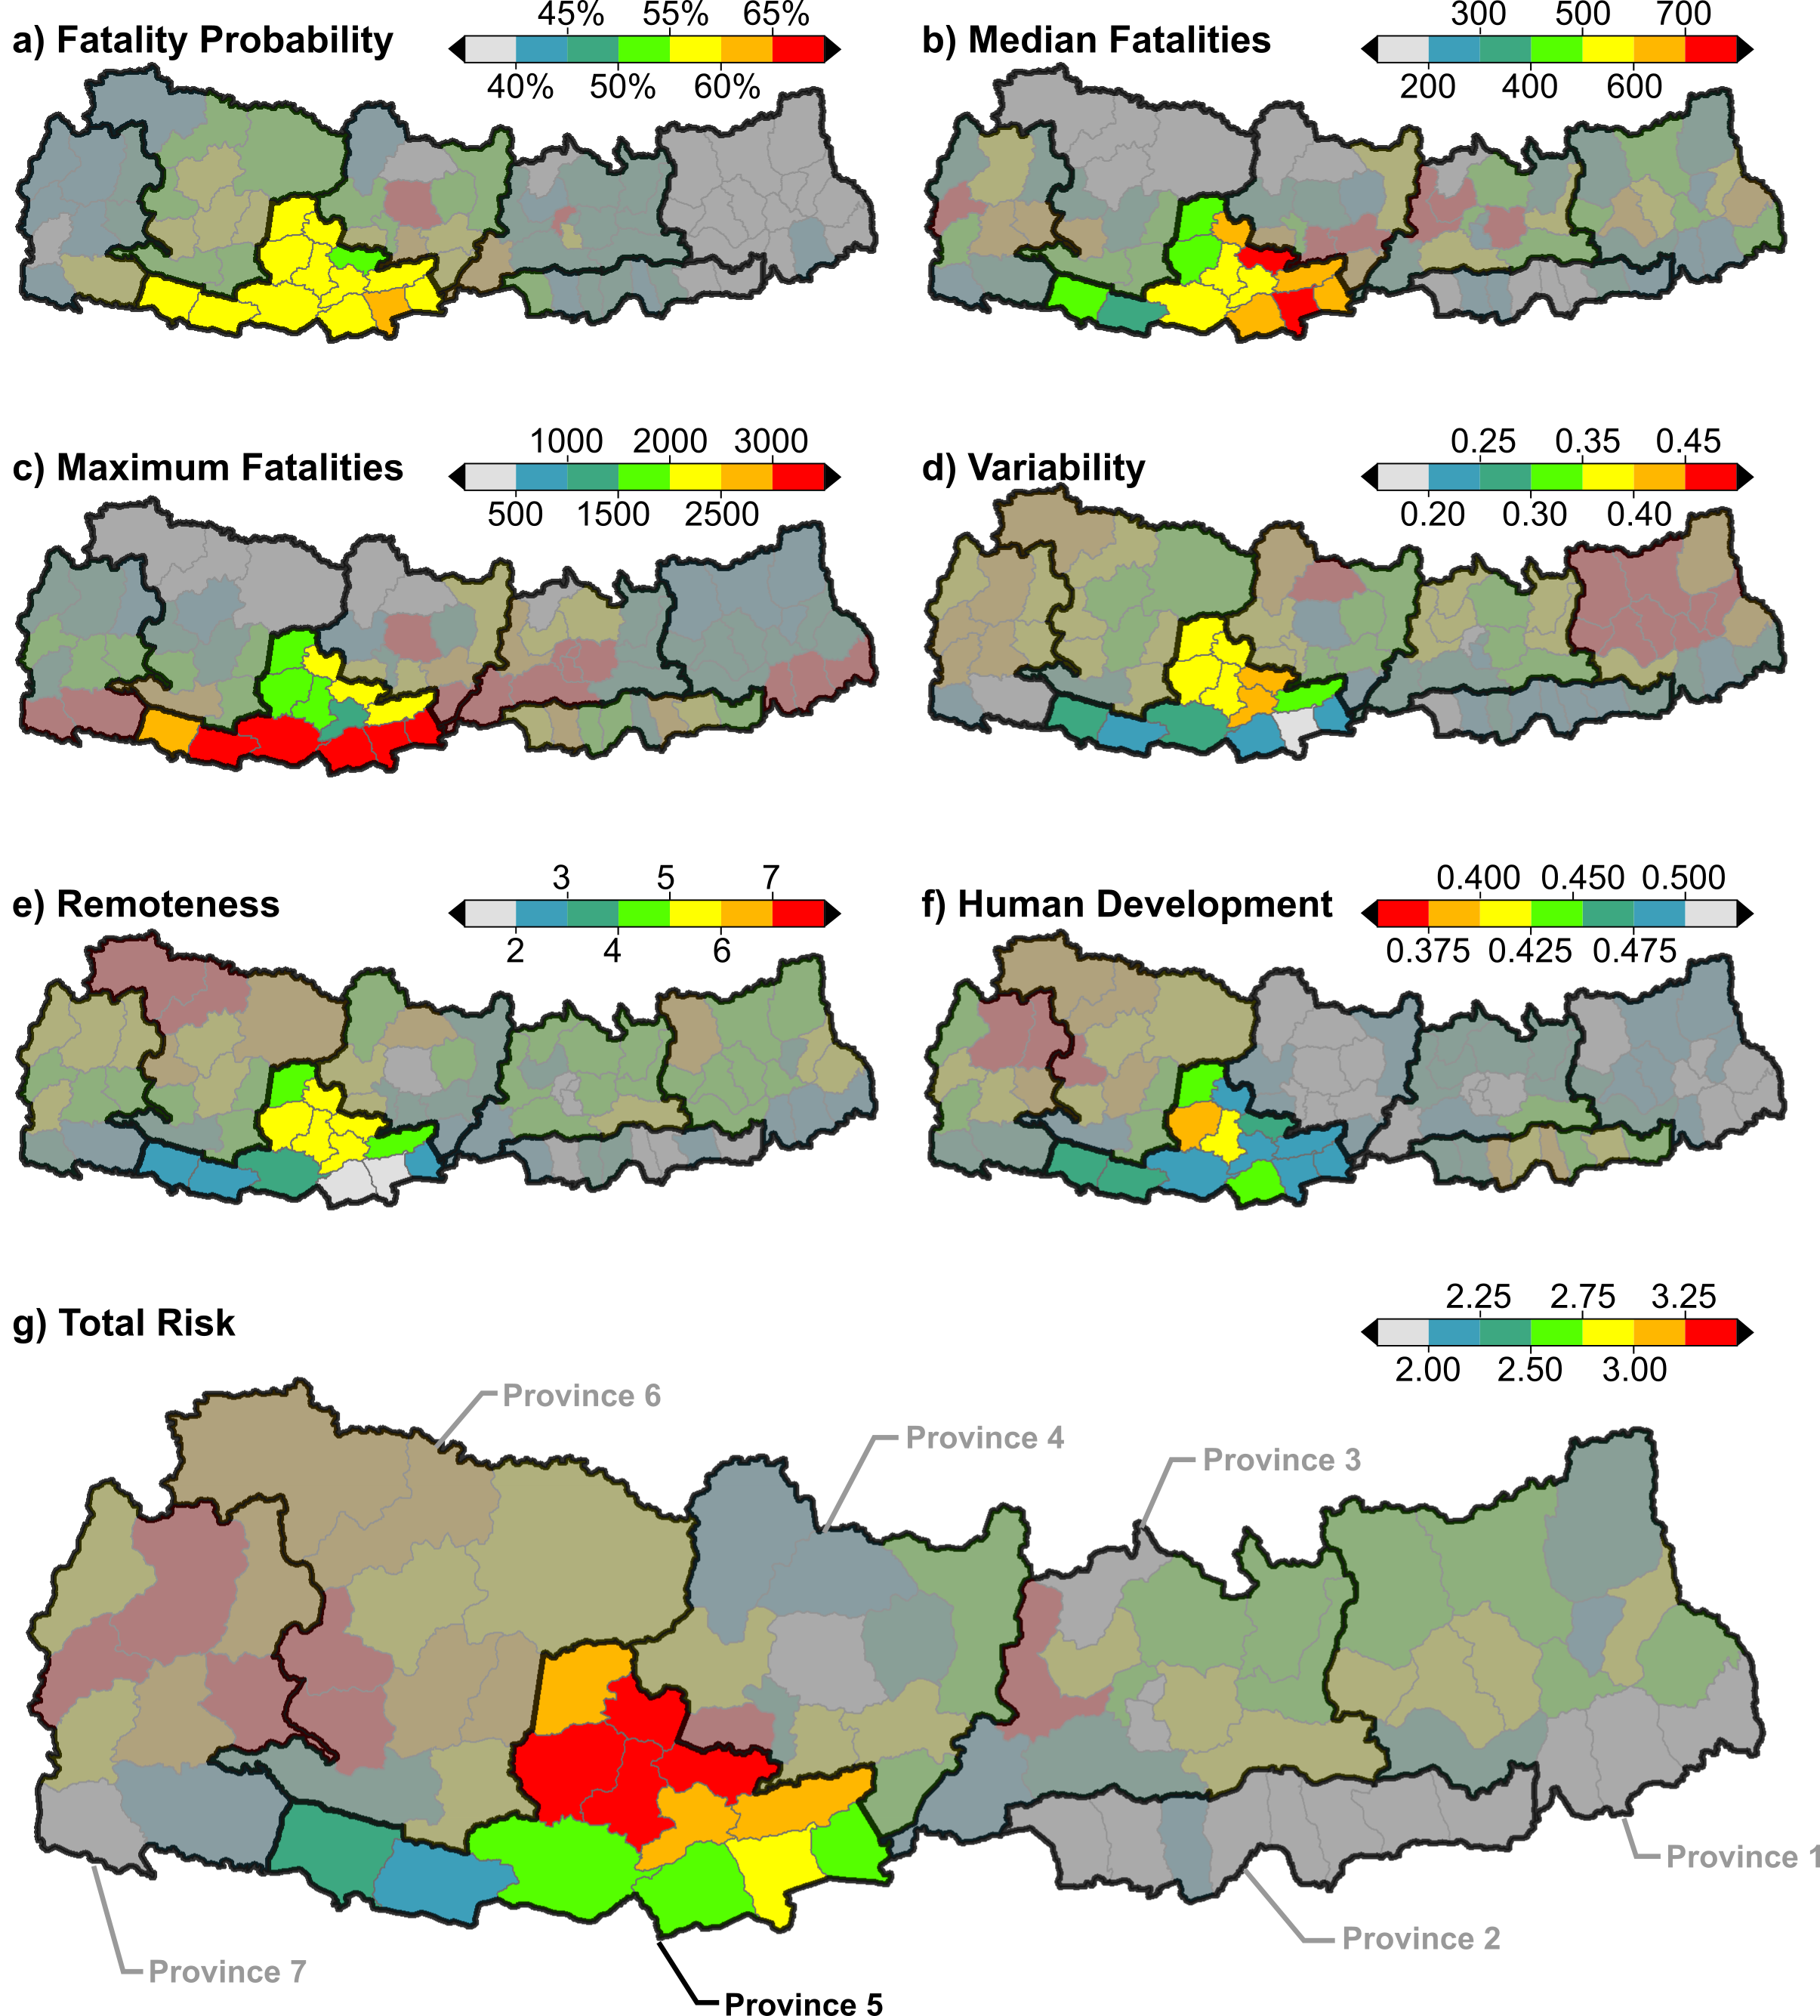
Province 5
Fatalities:
Likelihood: 77%
Average: 4,500
Worst-case: 35,000 Variability: 0.218 - Avg
Injuries:
Likelihood: 96%
Average: 25,000
Worst-case: 202,000
Variability: 0.236 - Avg
Building Damage:
Likelihood: 87%
Average: 17,000
Worst-case: 107,000 Variability: 0.308 – Avg
* Worst-case in hills – 44,000
* Average in terai – 3,000

Slide 12
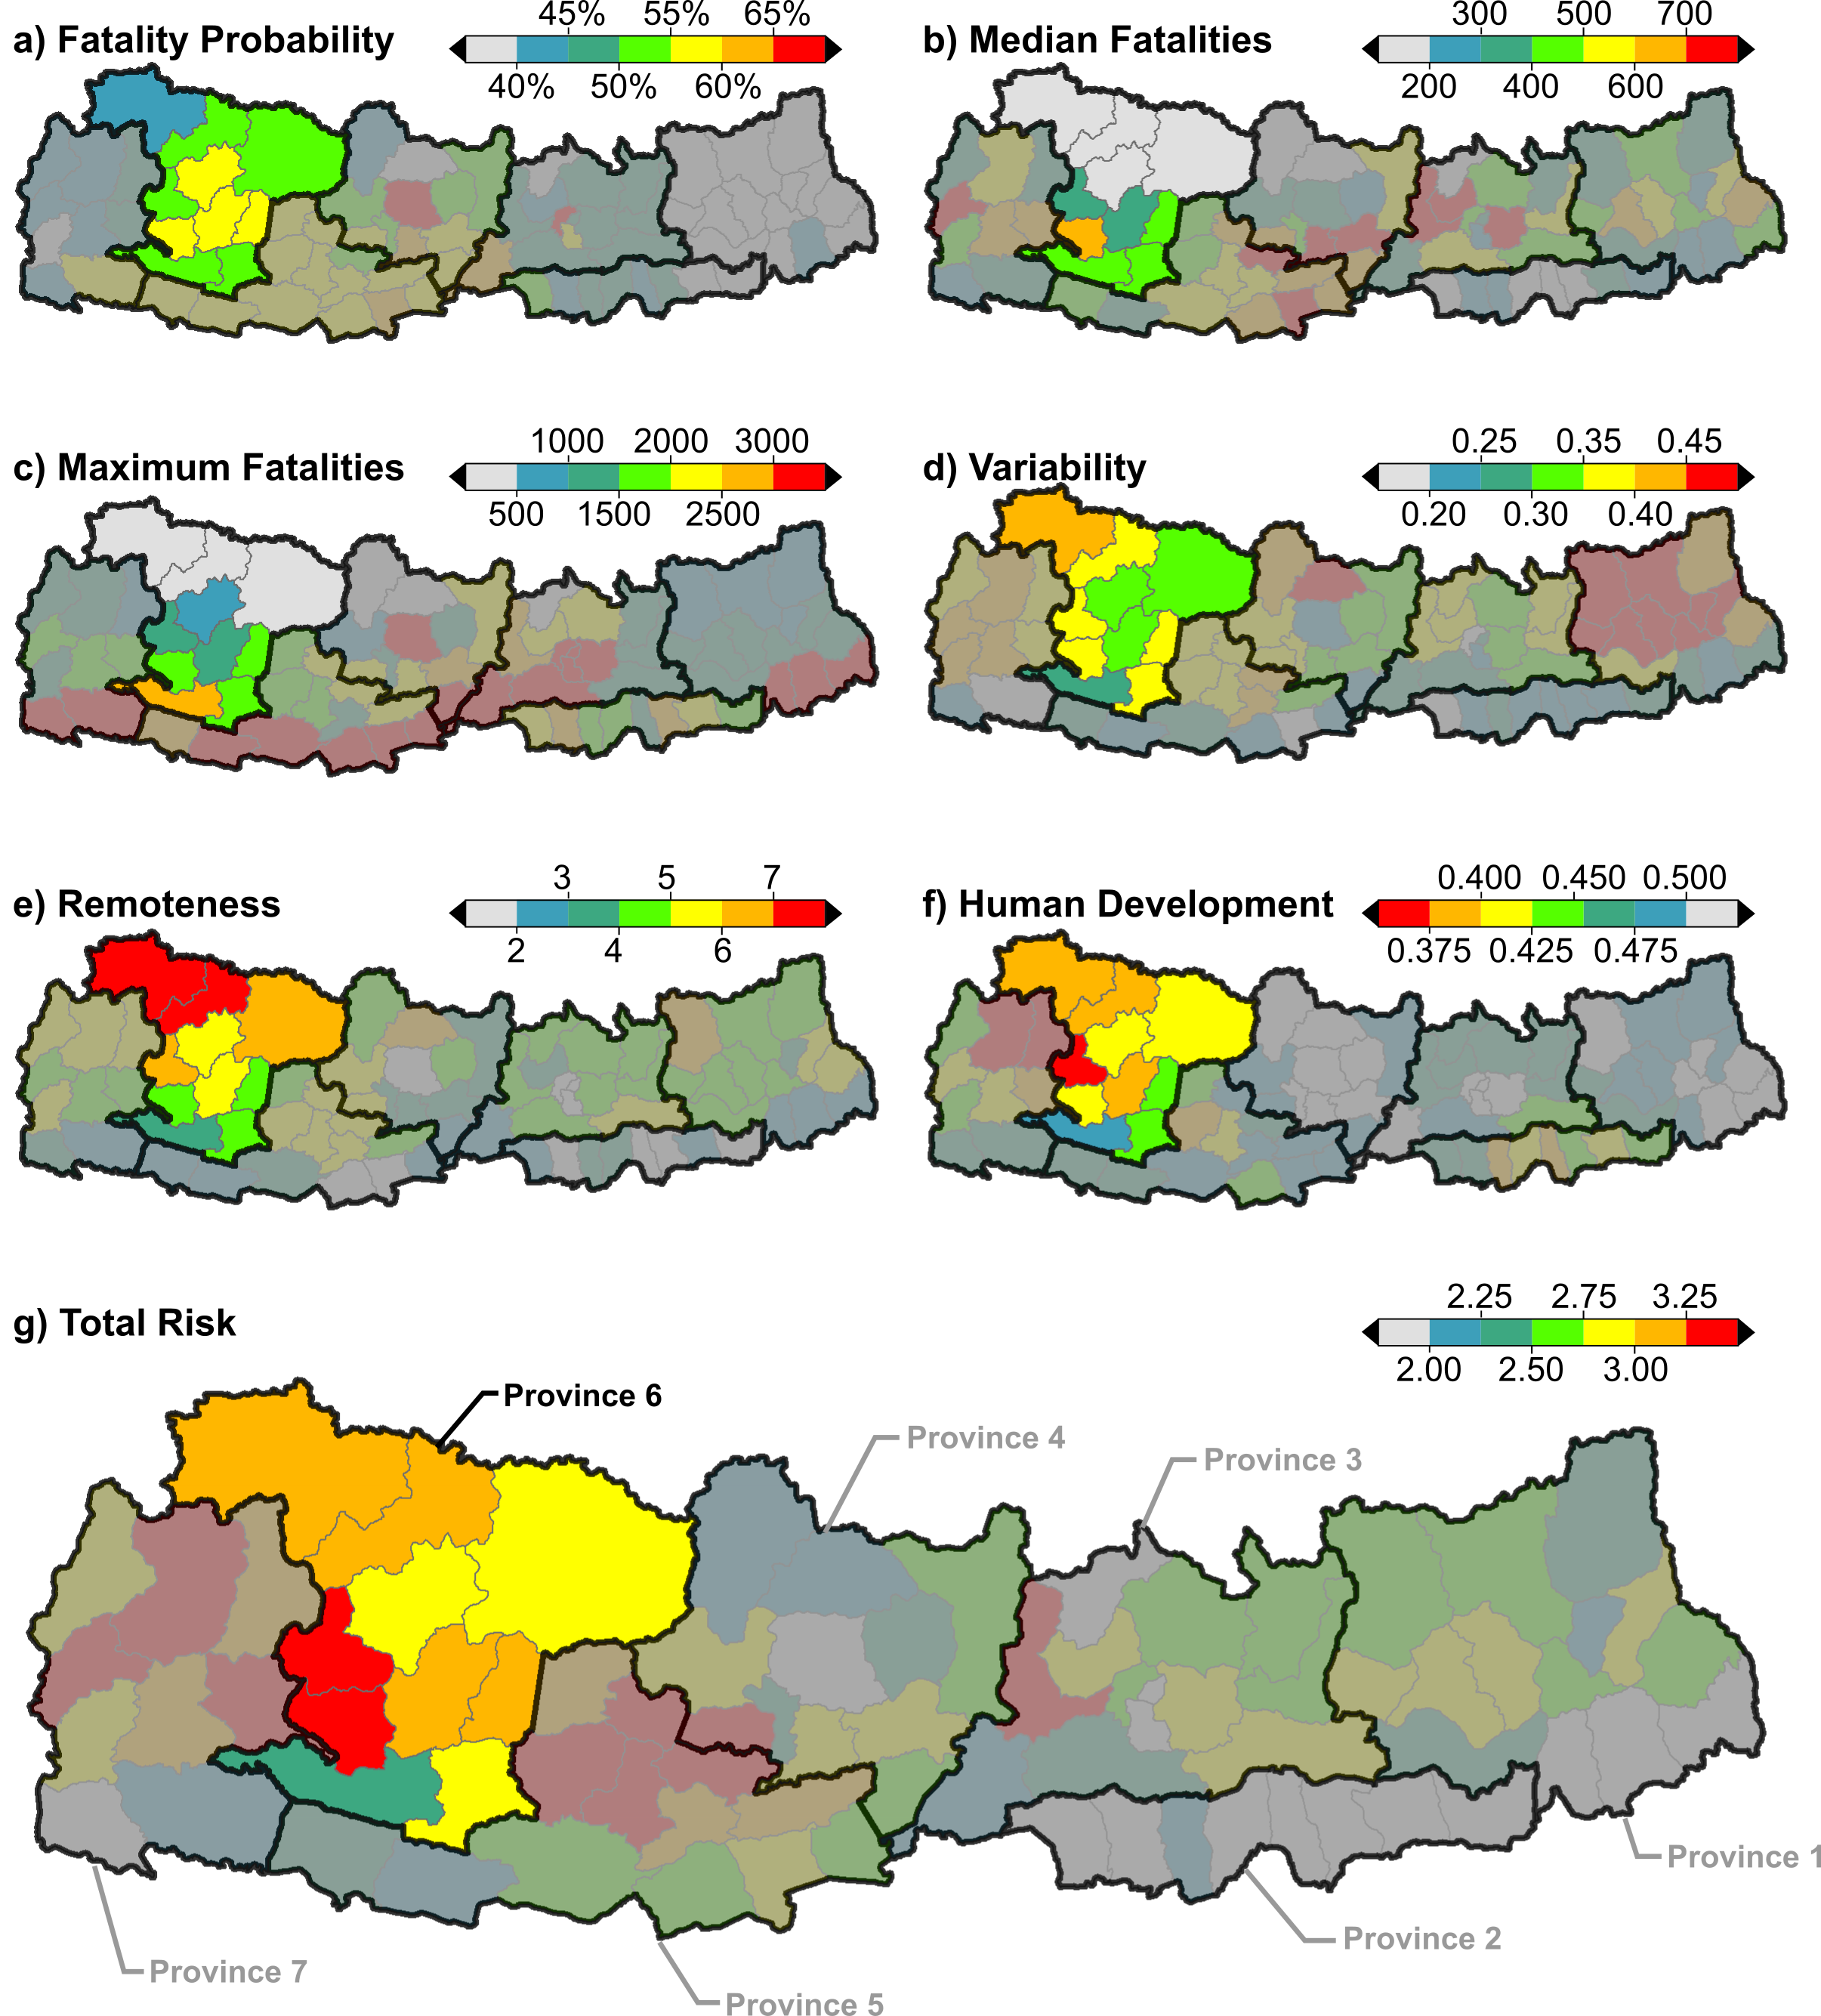
Province 6
Fatalities:
Likelihood: 64%
Average: 2,200
Worst-case: 11,000 Variability: 0.288 - Avg
Injuries:
Likelihood: 82%
Average: 11,000
Worst-case: 84,000
Variability: 0.278 - Avg
Building Damage:
Likelihood: 70%
Average: 10,000
Worst-case: 42,000 Variability: 0.388 - Max

Slide 13
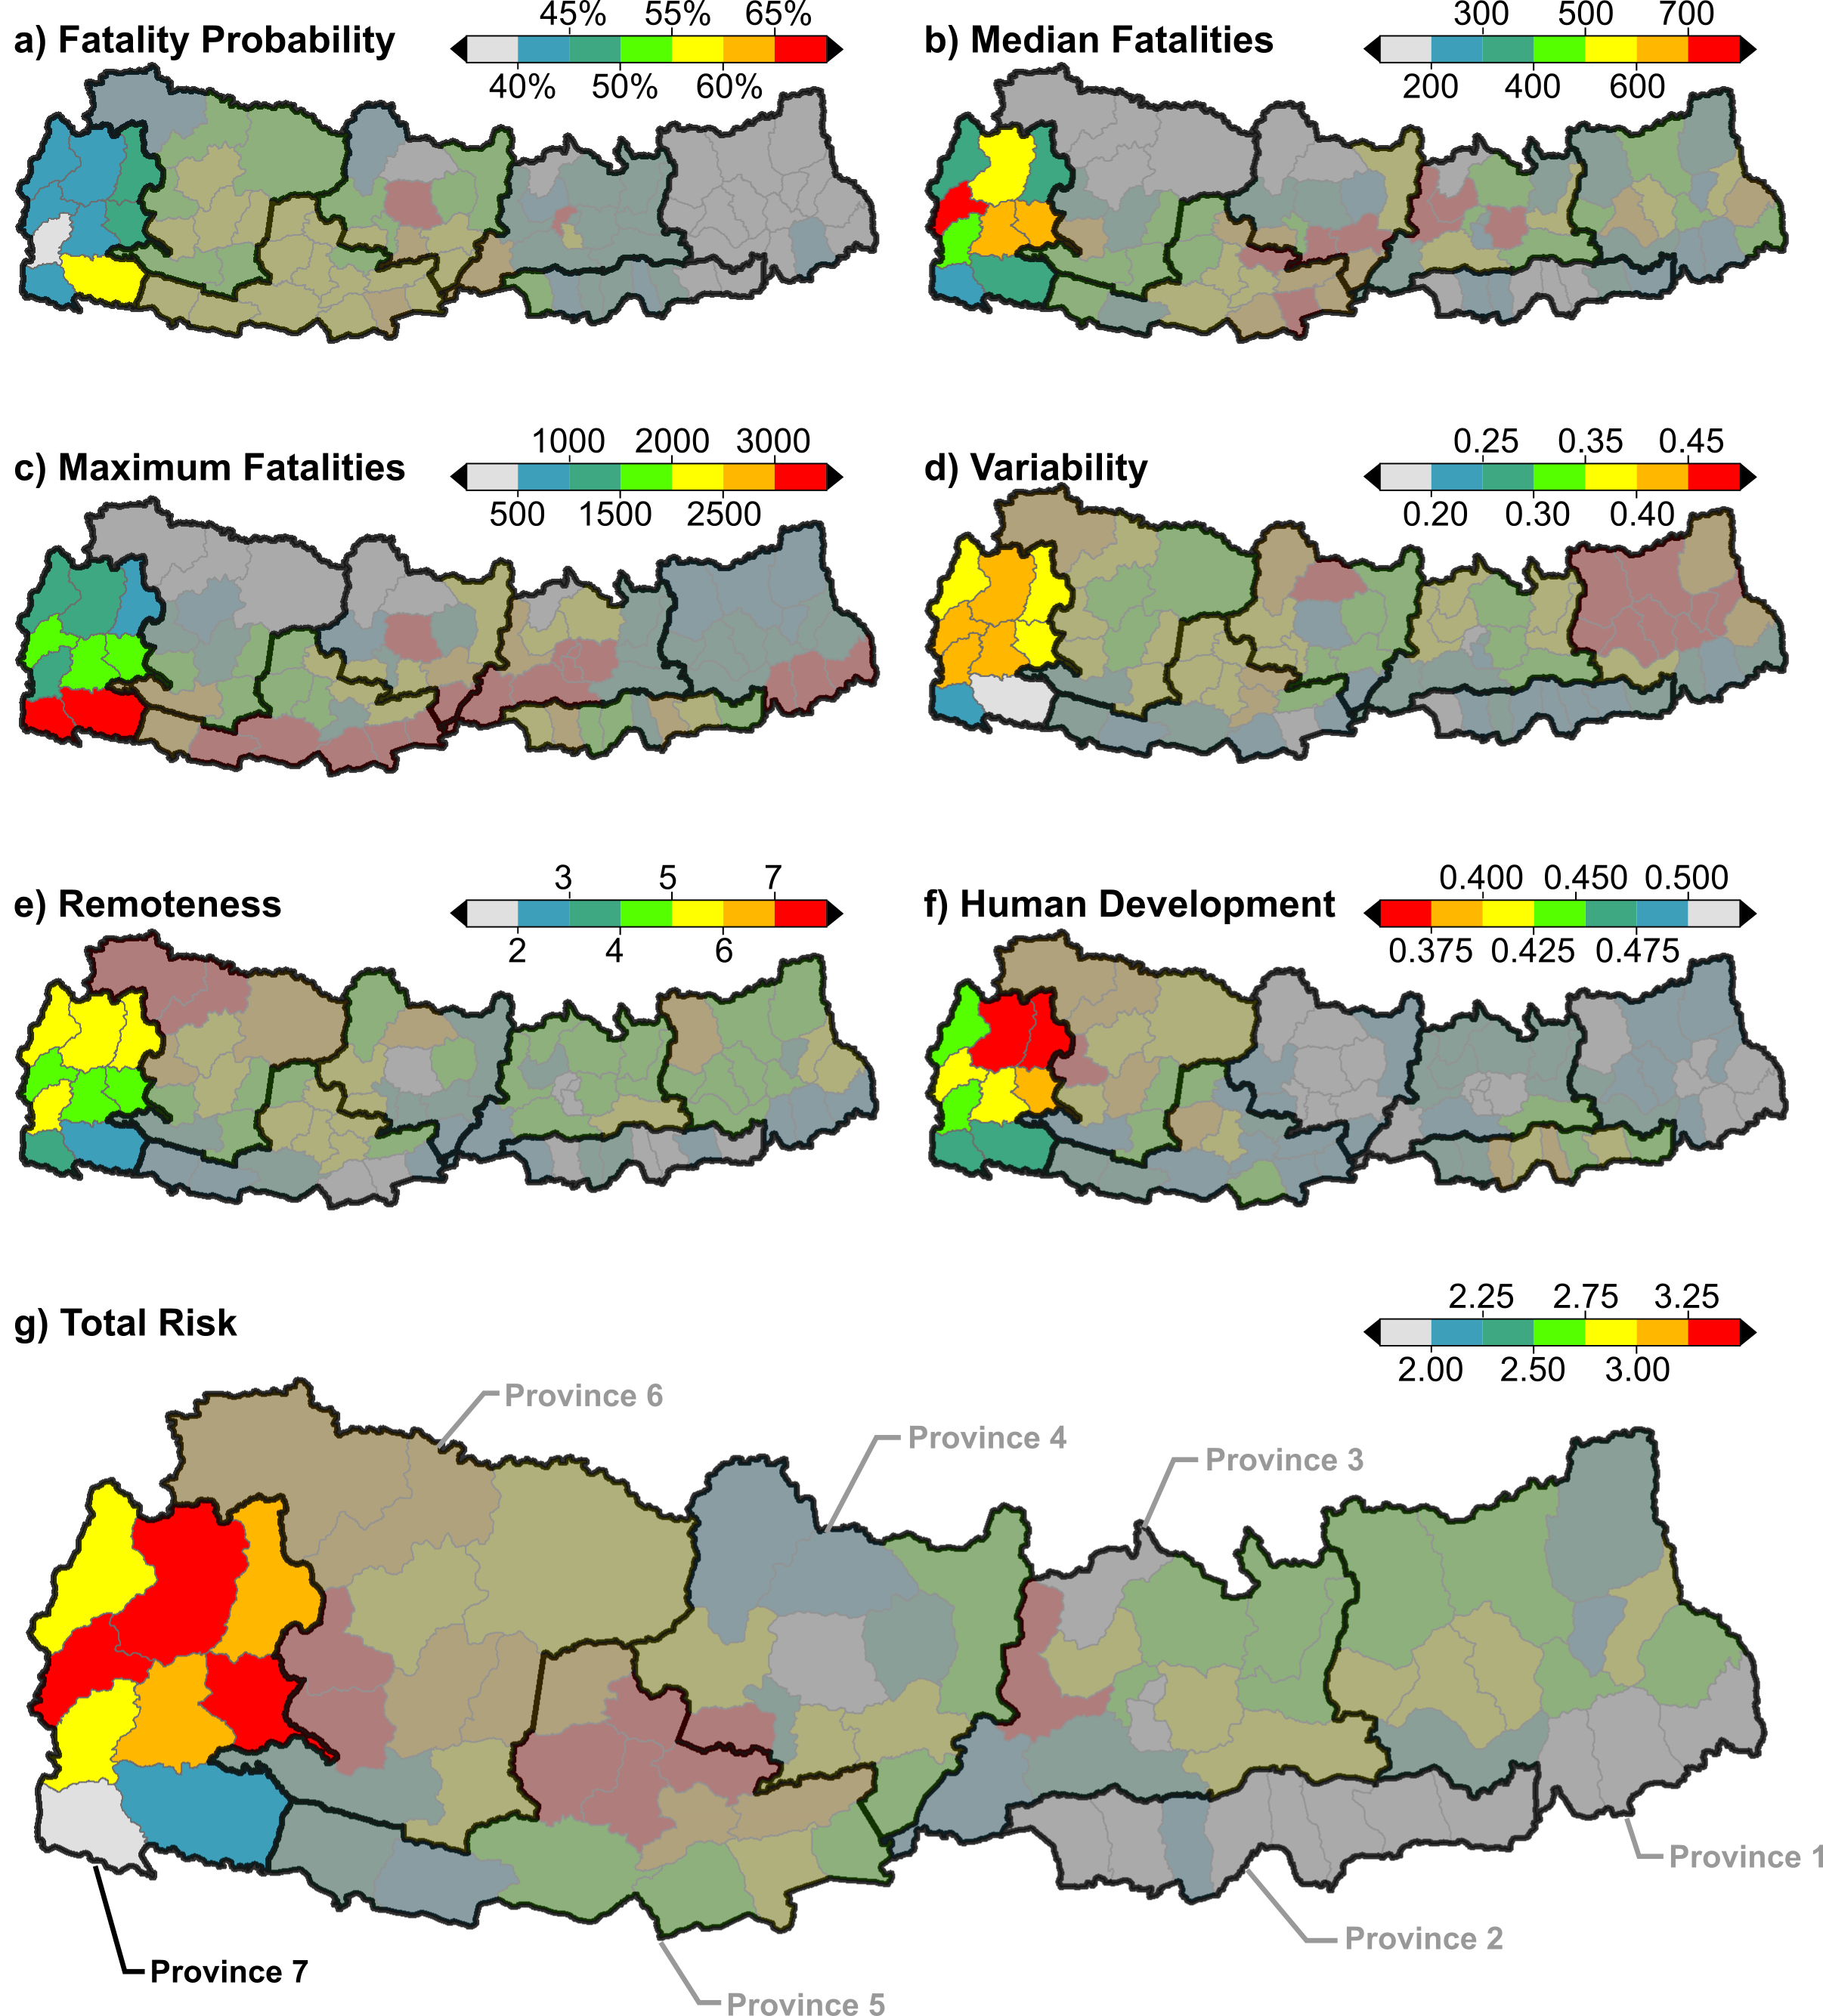
Province 7
Fatalities:
Likelihood: 61%
Average: 2,000
Worst-case: 17,000 Variability: 0.250 - Avg
Injuries:
Likelihood: 80%
Average: 6,000
Worst-case: 109,000
Variability: 0.253 - Avg
Building Damage:
Likelihood: 63%
Average: 10,000
Worst-case: 53,000 Variability: 0.376 - Max

Slide 14
Thank you!

